Slide 1
2012 Winning T-shirt Designs
Instructions for:
IEEE CIS Student Chapters
IEEE CIS Chapters
CIS-Sponsored Conference Organizers
Notes:
Your report must be a PPT containing no more than 10 slides (you can submit also complementary stuff if needed). It should contain:
-List of committee members and role
-Plan of activities for 2012 (if you have not discussed it with me yet please do it in advance so that we can iterate)
- Make it clear which tasks will be completed before ADCOM meeting in mid June, in particular if money is required
-Report tasks completed or under progress, difficulties, etc
- Please read again the email that I sent you in January (see at bottom), in particular the last point about Operation Manual (please include it in your list of tasks).
Please notice also that your presence is needed for the ADCOM meeting series to be held in Brisbane, Australia:
Saturday June 9, 10am-12pm: Members Activities Committee meeting (you have to present your report)
Sunday June 10, 8am-6pm: IEEE CIS ADCOM meeting (you have to present your report)
Please make travel arrangements in advancement by yourself. After the meetings you have to submit an expense report to the IEEE CIS, in order to get reimbursement of your air ticket (usually limited to US$1,500), hotel and food.
best regards
Pablo
On 14 January 2012 00:48, Pablo Estevez <pestevez@yahoo.com> wrote:
Dear Demetrios,
On behalf of IEEE Computational Intelligence Society (CIS), I would like to thank you for accepting to serve as the chair of CIS Student Activities Subcommittee in year 2012. ExCom has approved your appointment, so it becomes official.
Since Student Activities Subcommittee is an established committee under Members Activities Committee, you should familiar yourself with the charge defined below.
According to CIS Bylaws, Article XI: GOVERNANCE AND ADMINISTRATION, Section 20:
“The Members Activities Committee is responsible for overseeing membership development and members activities and services as described in the CIS Constitution. In particular, but not limited to the following, the Members Activities Committee shall:
(a) make recommendations on matters concerning member activities, including proposals for new regulations on member activities,
(b) prepare, develop, and recommend plans for member activities,
(c) prepare, develop, and recommend the budget for member activities,
(d) stimulate the submission of proposals for members activities,
(e) review proposals for members activities,
(f) recommend sponsorship, co-sponsorship, or technical co-sponsorship of CIS members activities,
(g) monitor members activities,
(h) collect statistical information on CIS members activities,
(i) report on members activities as requested by the President, the Vice President for Finances, the ADCOM, or the IEEE.
The Members Activities Committee reports to the Vice President for Members Activities.”
In practice, a commitment to this position is expected to fulfill seven major roles:
1) To establish Student Activities Subcommittee membership and maintain its website.
2) To set up and execute a plan of activities for the year 2012 with the help of subcommittee members.
3) To continue existing practices and explore new avenues to further CIS missions in membership development and outreach.
4) To prepare committee reports for the planned IEEE/CIS Administrative Committee (AdCom) meeting in Brisbane, Australia (June 8-10, 2012). Please be aware that your report will be expected ONE MONTHprior to the AdCom meeting series. We will be making every possible effort to have ALL reports posted on time. In 2011, we were able to achieve this goal thanks to each and every volunteer. A reminder will be sent for your reference. Note: Only one ADCOM meeting will be held in 2012 due to budget constraints.
5) Your presence at the June AdCom meeting is expected to brief progress made on subcommittee activities to AdCom and to be available for any Q&As. Travel expenses (economic air ticket and accommodation during the meeting) are reimbursed by IEEE. You have to make your flight and hotel reservations in advance.
6) To prepare committee reports for the planned IEEE/CIS Executive Committee (ExCom) meeting: a first one in New York, US (March 30, 2012), and then one or two additional Excom meetings during the year. Please be aware that your report will be expected ONE WEEK prior to each ExCom meeting series. We will be making every possible effort to have ALL reports posted on time. A reminder will be sent for your reference. You DO NOT have to attend ExCom meeting, just to submit your report.
7) You should exchange ideas often with your subcommittee members through emails and teleconference session. In general it is a good idea to copy me, and sometimes the president, so that we are informed of your work and what is going on. As a general rule, it is good to have some kind of communication at least once per month.
A few action items call for your immediate attention:
ACTION ITEMS:
· Please provide me with a list of your desired subcommittee members at your earliest convenience (please care for a geographical balance and consider gender too). Please consult with me first. Upon approval by President, the appointment of subcommittee membership will then become official. It is essential that this list could be finalized by the end of January. NOTE: there are no subcommittees for travel grants administrator, E-letter manager and Website Manager.
· Once the list is finalized, please collect all needed information (contacting information and photo) and forward them in an organized fashion to our Webmaster, Haibo He at he@ele.uri.edu. Please work diligently with Haibo to have the Student Activities webpage in our website updated by mid February. I would like to see ALL information in place, including photo and address of each subcommittee member. This is also a good time to review the webpage to update any out-of-date information.
· Set up a plan of activities for 2012 with the help of your subcommittee members. If you are new in this position please contact the former chair and VP Members Activities. This plan should be completed bymid February.
· As a result of the Society Review process, it has been established that we need to write an Operation Manual. Please include as a main activity during the first part of 2012 the writing of an operation manual related to your subcommittee procedures & guidelines. Include best practices, lessons learnt, guidelines for the chair of the subcommittee (this will be useful for the next chair or manager).
Please keep this email for future reference as it contains many important notes and a to do list. Please do communicate with me (pestevez@cec.uchile.cl) as needed to identify creative ways to further improve theStudent activities within CIS.
Best regards,
Pablo A. Estevez, VicePresident Members Activities
IEEE Computational Intelligence Society 2011-‘12

Slide 2
T-shirt Competition
Competition was organized in 2012 by the IEEE CIS Student Activities Subcommittee
15 designs submitted, 3 winners were decided by voting.
  1st prize: Steven Van Vaerenbergh
  2nd prize: Alexander Steinkogler
  3rd prize: Francesca Cecion

Slide 3
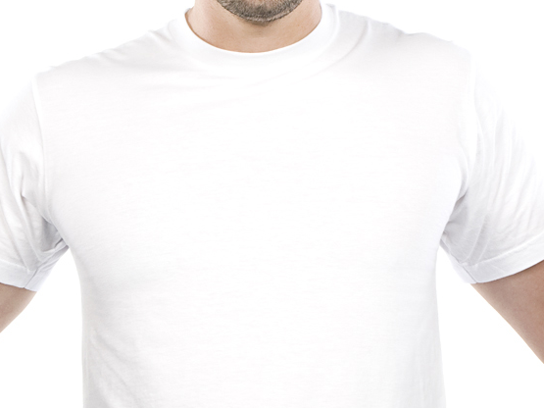
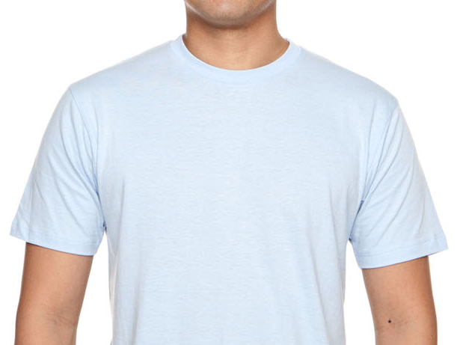

Steven Van Vaerenbergh whiteshirt center.svg
1st Prize
Steven Van Vaerenbergh,
Spain

Slide 4
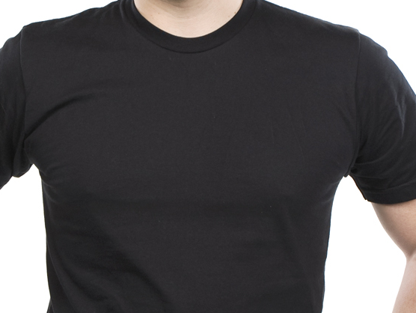
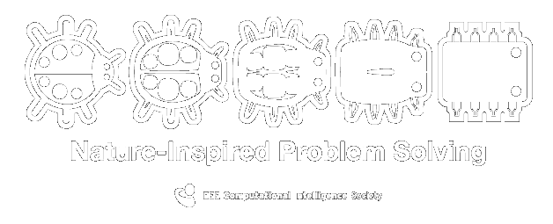
Steven Van Vaerenbergh blackshirt center.svg
1st Prize
Steven Van Vaerenbergh,
Spain

Slide 5
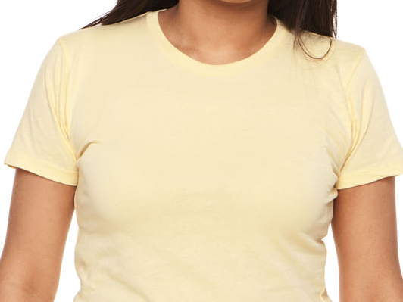

Alexander Steinkogler.svg
2nd Prize
Alexander Steinkogler,
Germany

Slide 6
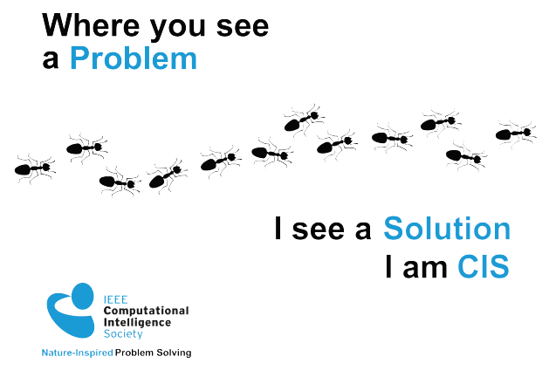
Francesca Cecioni.svg
3rd Prize
Francesca Cecion,
USA

Slide 7
Design Files
For all designs, the SVG and PDF files are available
SVG files can be opened and edited with inkscape, an open-source drawing software (inkscape.org)
All designs are in vector form, and can modified without loss in the quality

Slide 8
Licence
According to the rules of the 2012 T-shirt competition organized by the IEEE CIS, all participants have agreed that their designs will be provided under the Creative Commons License (cc by 3.0), which allows sharing and remix.
This means that the anyone is free to extend these designs or improve them. Also this means that that the designs will be available for our student members to use in promoting CIS to other students, by printing T-shirts, posters etc.
For more information visit: http://creativecommons.org/licenses/by/3.0/

Slide 9
Guidelines
You can use the designs along with any other design, as long as the IEEE CIS logo and slogan are visible.
Feel free to move elements, add more colors or use part of the designs to make a new design, in accordance to the CC-BY 3.0 Licence.

